Slide 1
USER-CUSTOMIZED RESTAURANT RECOMMENDATION USING NLP ON YELP DATASET
Spring 2020: CSE6240: Web search and Data Mining
Somdut Roy
Vitaly Marin
Devanshee Shah
CSE6240: Web search and Data Mining Somdut Roy, Vitaly Marin, Devanshee Shah

Slide 2
Introduction
Problem Description:
Given a user with a favorite restaurant name/type, we aim at building a recommender system that provides a list of relevant restaurants in the city along with a possible rating he/she is likely to give those restaurants.
This breaks our problem into two distinct parts
A rating predicting system (to predict ratings for suggested restaurants)
A recommender system (to suggest those restaurants to a user)
Problem Importance:
This provides a user, a list of restaurants only based on the information about favorite restaurant.
Along with that, our model is capable of predicting the stars that the user is going to give each of those recommended restaurants. Here lies the uniqueness in our problem.
CSE6240: Web search and Data Mining Somdut Roy, Vitaly Marin, Devanshee Shah

Slide 3
Data Discovery
CSE6240: Web search and Data Mining Somdut Roy, Vitaly Marin, Devanshee Shah

Slide 4
Dataset Properties
Yelp Dataset for Business Reviews provided by Kaggle was used for our study after extracting only “restaurant” business of city Avondale, AZ from JSON file of around 6GBs. Final dataset of 7MBs consists of around 10k-12k data points (reviews).
Dataset Attributes include Review Id, User Id, Restaurant Id, Restaurant Name, Stars, Text Review and Date. Data ranges from 2005 till 2018 with 8031 unique users and 163 unique restaurants.
Test Reviews are used for sentiment analysis. Ratings (1 to 5 stars) used to find the cosine similarities among restaurants.
# Reviews | Features | # Users | # Restaurants
12662 | Review Id, User Id, Restaurant Id, Restaurant Name, Stars, Test Review and Date | 8031 | 163
CSE6240: Web search and Data Mining Somdut Roy, Vitaly Marin, Devanshee Shah

Slide 5
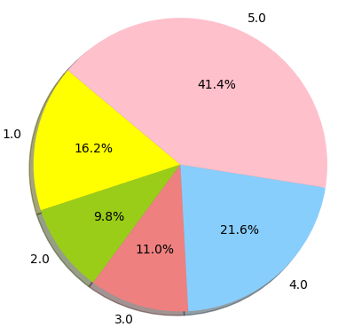
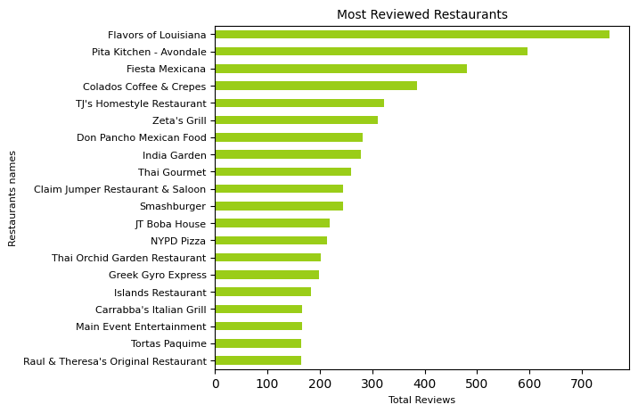
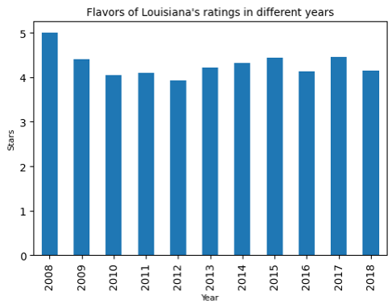
Dataset Highlights
Star distribution for the restaurant is not uniform. More than 60% restaurants are rated very high. (4 and 5 stars).
‘Flavors of Louisiana’ is to most reviewed restaurant in Avondale with more than 700 reviews.
‘Flavors of Louisiana’ consistently gets more than 4 over all the years.
CSE6240: Web search and Data Mining Somdut Roy, Vitaly Marin, Devanshee Shah

Slide 6
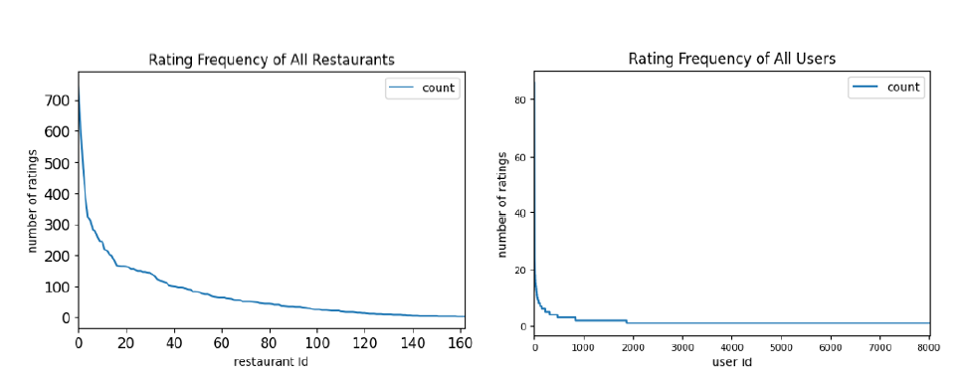
Dataset Insights
Distribution of Rating Frequency of all the restaurants and frequency of ratings provided by users, both follow long tail property.
That means, very few restaurants are rated very frequently - which are called the popular restaurants. Similarly, very less users are interested in rating the restaurants.
CSE6240: Web search and Data Mining Somdut Roy, Vitaly Marin, Devanshee Shah

Slide 7
Methodology
CSE6240: Web search and Data Mining Somdut Roy, Vitaly Marin, Devanshee Shah

Slide 8

Methodology: Overall Architecture
Yelp Restaurant Review-Rating Database
Reviews + ratings
Ratings
Rating Prediction: Baseline
Rating Prediction: Our Approach
Recommender System
Aggregated Restaurant Reviews
Aggregated User Reviews
Reviews
User*Restaurant Sparse Rating Matrix
kNN Item Based Collaborative Filtering
Review fastText representation
User-Restaurant Assoc Matrix
Rating Prediction Training
SVM
Logistic Regression
+Ratings
Rating Prediction Training
Baseline 1: SVM (Kulkarni et al.)
Baseline 2: Logistic Regression
+Ratings
Restaurant Recommendation with Hybrid Rating Prediction
CSE6240: Web search and Data Mining Somdut Roy, Vitaly Marin, Devanshee Shah

Slide 9
Methodology: Text Encoding and Assoc Matrix Creation I
Our baseline is based on a paper by Kulkarni et al., where they use review text to predict the ratings.
While we use their machine learning techniques to create our baselines, the paper does not specify the method for word embedding. This gives us liberty to explore options for word embedding techniques.
In assignment 2 of this course, we learned to use word2vec. So that was an option. However, going by a blog by Anon (2016), using fastText suits best for a moderately small dataset like ours.
We create embedding for reviews using the method shown here 🡪
Review Sentence
Remove Stopwords
Remove html tags
Remove special characters
Filtered Review Words
(trained using review dictionary of our data)
Set of vector representations of review words
Averaging vectors
Review Vector
CSE6240: Web search and Data Mining Somdut Roy, Vitaly Marin, Devanshee Shah

Slide 10
Methodology: Text Encoding and Assoc Matrix Creation II
YELP REVIEW-RATING DATABASE
🡪
Set of reviews
Ratings
Aggregated reviews for each user
Aggregated reviews for each restaurant
Aggregated Restaurant Review Vector
Aggregated User Review Vector
CSE6240: Web search and Data Mining Somdut Roy, Vitaly Marin, Devanshee Shah

Slide 11
Methodology: Text Encoding and Assoc Matrix Creation III
Process of creating Assoc vector
Assoc matrix from Assoc vector
Example:
User-i: Restaurant-j: Star-ij
Appended User-1 Restaurant-1 Assoc Vector
: Star-11
Appended User-2 Restaurant-2 Assoc Vector
: Star-22
Aggregated User-i Review Vector
Aggregated Restaurant-j Review Vector
Appended User-i Restaurant-j Assoc Vector
: Star-ij
Appended User-i Restaurant-j Assoc Vector
Appended User-m Restaurant-n Assoc Vector
: Star-mn
Assoc Matrix
CSE6240: Web search and Data Mining Somdut Roy, Vitaly Marin, Devanshee Shah

Slide 12
Methodology: Rating Prediction
Baselines
As input, we use the fastText representation of each review.
We train this input to predict ratings (1-5) with
SVM with Linear kernel (Kulkarni et al)
Logistic Regression
Our Approach: Using Assoc Matrix
Assoc matrix is used as the input to train for rating prediction.
Like baselines we use
SVM with Linear kernel
Logistic Regression
Description of the experimentation setup .
We used Google Colab to run our experiments.
To ensure fair comparison between different processes, interferences from other processes was kept to a minimum.
For accuracy, we used F1 score as the metric.
We use k-fold (k=5) cross validation to get the parameters corresponding to optimum accuracy.
For Linear SVM, we play with regularization hyperparameter C.
For Logistic Regression, we finetune the “inverse of regularization strength” parameter C.
Description of evaluation criteria for the experiment:
The success of our experiment was evaluated with the accuracy of predicted stars.
CSE6240: Web search and Data Mining Somdut Roy, Vitaly Marin, Devanshee Shah

Slide 13
Methodology: KNN –Item based Collaborative Filtering
User- Restaurant Sparse Matrix for Collaborative Filtering
Fuzzy method is used with fuzzy ratio as 40% to find the closest matched restaurant in our dataset to the given input query.
We fit the sparse user-restaurant matrix into KNN model with k= 20 neighbors. KNN measures cosine similarity between restaurant vectors.
We get top 10 nearest neighbors of the closest matched restaurant with the distances.
Result distances further computed with user-restaurant assoc matrix to get hybrid ratings.
Users
 | 1 | 2 |  | n-2 | n-1 | n
1 | 0 | 3 |  | 4 | 4 | 3
2 | 1 | 2 |  | 4 | 3 | 2
m-2 | 2 | 4 |  | 3 | 2 | 0
m-1 | 2 | 4 |  | 3 | 2 | 0
m | 1 | 2 |  | 4 | 5 | 3
Restaurants
Restaurants m-2 and m-1 are having very high cosine similarity based on the ratings to both the restaurants given by users 1, 2, n-2 and n-1.
CSE6240: Web search and Data Mining Somdut Roy, Vitaly Marin, Devanshee Shah

Slide 14
Methodology: Recommendation & Hybrid Rating
Item-based Collaborative Filtering
We use Item based Collaborative Filtering to get restaurant recommendation list based on a user’s “favorite restaurant”.
Creating input matrix using stored user and restaurant “review profile vector”:
We already have the “review profile vector” for the user in question and the recommended restaurants. Appending the user vector to each of the restaurant vector gives us the input matrix.
Rating Prediction for Recommended Restaurants
We implement our best-performing Assoc-trained model on the input matrix to predict ratings on all the recommended restaurants for the user.
Hybrid Rating for Restaurants
The output of Item-Based Collaborative Filtering comes with a distance metric. We multiply our predicted ratings with the distance metric to create a relevance-preference hybrid rating.
Sorting Restaurants on Hybrid Rating
Finally, we sort the recommended restaurants in the decreasing order of hybrid rating.
CSE6240: Web search and Data Mining Somdut Roy, Vitaly Marin, Devanshee Shah

Slide 15
Results
CSE6240: Web search and Data Mining Somdut Roy, Vitaly Marin, Devanshee Shah

Slide 16

Results: Rating Predictions
Accuracy
Key difference between baselines and our approach
The baselines are using individual reviews to predict ratings
Our approach on the other hand uses the aggregated user and restaurant review profile to predict ratings
Cons of our approach
We lose some inherent domain knowledge when we use all their reviews in general instead of actual user-restaurant specific review. That causes a slight dip in accuracy compared to the baselines.
Pros of our approach
Our approach allows us to have predicted ratings for a user to a restaurant that he or she has not necessarily visited before. Since baselines needs actual reviews for the restaurant, it is unable to predict rating for a user that as not visited the place and put in a review
Unsurprisingly, the baselines do better in terms of accuracy.
Linear SVM and Logistic Regression gave similar accuracy ranging in 51 - 55 percent.
CSE6240: Web search and Data Mining Somdut Roy, Vitaly Marin, Devanshee Shah

Slide 17
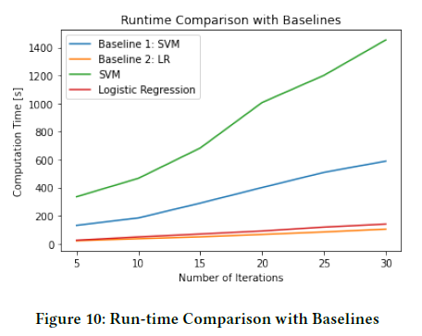
Results: Rating Predictions (continued)
Computation time
Linear SVM took significantly longer computation time than Logistic Regression
As shown in the graph for 30 iterations, SVM baseline suggested by Kulkarni et al. was 3X slower, compared to Logistic Regression on Assoc Matrix.
However, training Assoc matrix with Linear SVM took the longest (more than 10X of Logistic Regression baseline).
Verdict
Based on our findings, Linear SVM and Logistic Regression give similar accuracy.
However, Logistic Regression takes significantly less time for same accuracy. Hence, Logistic Regression is the way to go.

Slide 18
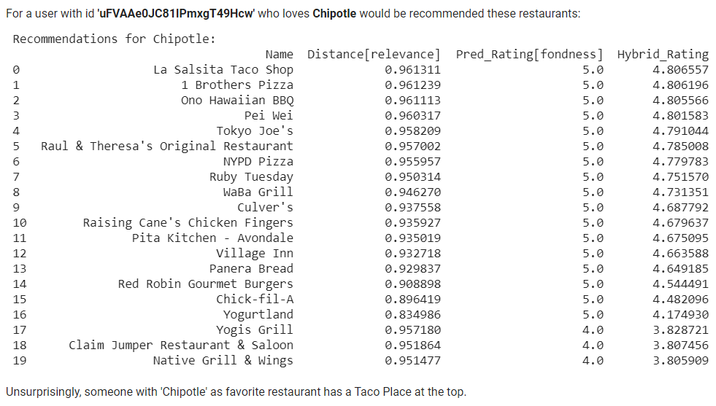
Results: Recommendation with Hybrid Rating

Slide 19
Conclusion
Uniqueness of our approach
Combining two worlds: The Novelty of our approach is to create the hybrid ratings by combining rating prediction for restaurants and Item based collaborative filtering to restaurant dataset together.
Limitations of our approach
Explored one document-to-vector approach: We took the average of the word vectors in a text piece to represent the given text to create our training matrix. We could explore other operations, such as simple summation of word-vectors.
Used only one word embedding technique: Other word embedding techniques such as GloVe could have been explored.
Ongoing Work and Future Prospects
Interactive GUI App: A GUI interface using Python’s Tkinter library is in the works.
Extending Collaborative filtering to reviews: We could use the reviews for the item based collaborative filtering in the future work to benchmark it against our other two approaches.
CSE6240: Web search and Data Mining Somdut Roy, Vitaly Marin, Devanshee Shah

Slide 20
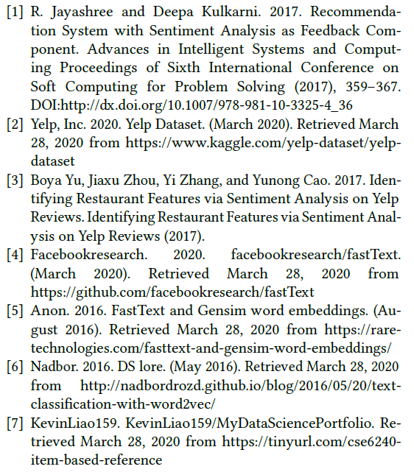
References:
CSE6240: Web search and Data Mining Somdut Roy, Vitaly Marin, Devanshee Shah

